Slide 1





Antifurto App
Mobile and Pervasive Systems
Daniele Battista
Mario Militello
Academic Year 2015/2016

Slide 2
General Overview
Antitheft App is a security app to use everytime you have to leave your smartphone in an unsafe place. When you’re at the beach or at a sports center, Antitheft is perfect.
Protect your phone from a thief
Check on a secure smartphone the position of your smartphone
Block it for a specific session
Block it till the end of battery thanks to a secure code
Look for your phone if you hear a particular alarm
See photos of the place in which the phone is and the possible thief
Hear his/her voice or particular sounds able to help you to locate it

Slide 3



Parameters Setting
First you have to set your security setting
Security Settings
In this tab you can set your secure phone numbers, your secure email addresses and your Permanent Code. In order to avoid problem with typing wrong numbers and emails you can use the contact button to retrieve it automatically.
Application Settings
In this tab you can set some features like the countdown timer, useful to unlock your smartphone in a safe way, the alarm you prefer and the sensibility of the accelerometer.

Slide 4

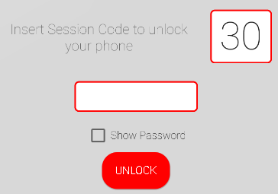
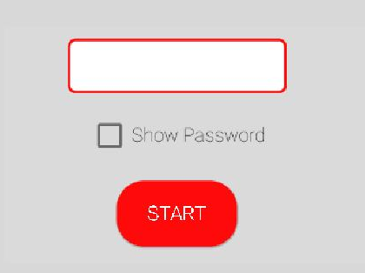
Lock and Unlock your device
Lock
Tap on the rocket and then insert your session code. This is a temporary code that you can change in each session. After confirmation, your phone is protected. You can leave it wherever you want.
Unlock
When the device detects a movement, the application locks the screen. You must enter your session code before the countdown is over.

Slide 5
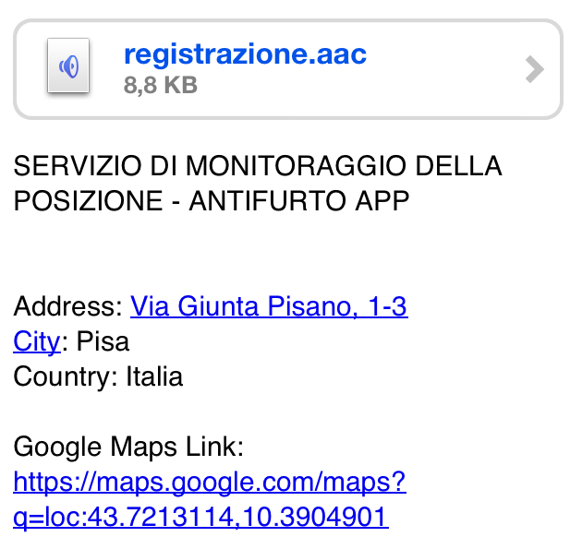
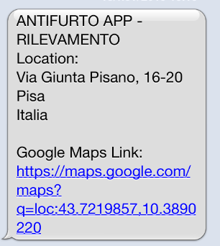
Know the thief
If the countdown ends and no code or wrong code is entered, the smarphone enters Alarm mode:
A loud alarm sound starts
The front camera takes hidden photos
The back camera takes hidden photos
The microphone starts to record the enviroment sounds
The app gets the position of the smartphone
The app geolocates the smartphone and found the exact address
Some SMSs with the address and a link to google maps are sent to secure friend’s telephone number
Some emails with the address, a link to google maps, hidden photos and audio recorded are sent to secure friend’s email address

Slide 6

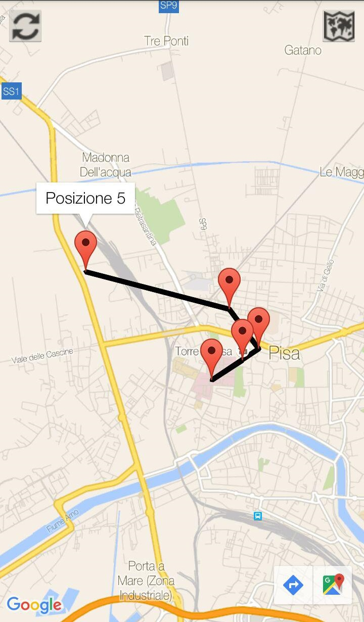
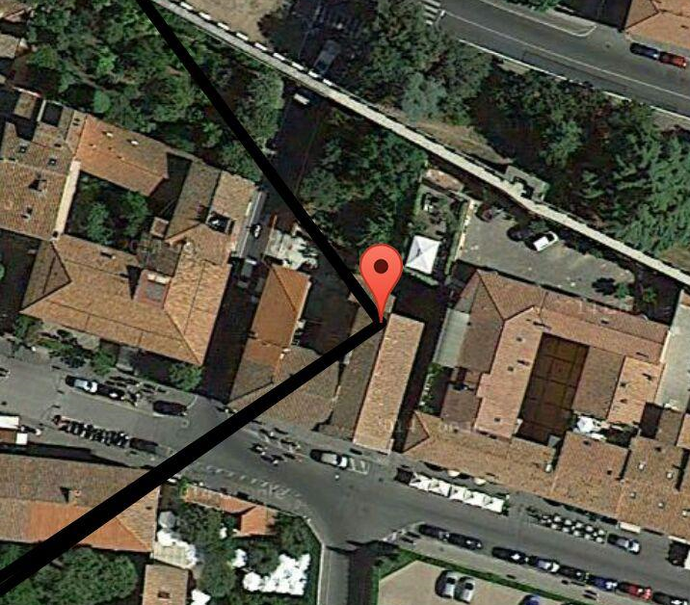
Map Tracking Activity
If your phone has been stolen, contact your friend and check positions in which your smartphone has been localized.
During your tracking activity you can update the positions, hoping some new message has been received.
If you want to know a specific building around a position, you can switch the map through the top right button.

Slide 7


Purposes
Detect movement of the smartphone through accelerometer
Register the voice and the sound around the smartphone in an hidden way
Take hidden pictures of the thief and of the environment
Contact secure people through email with attachments and SMS automatically
Block all key buttons to avoid thief interaction with data in the smartphone
Safe delete of smartphone external storage through a receiving “secure SMS”
Track thief movement in order to take back the smartphone
Let the smartphone be localizable through a loud personal alarm

Slide 8

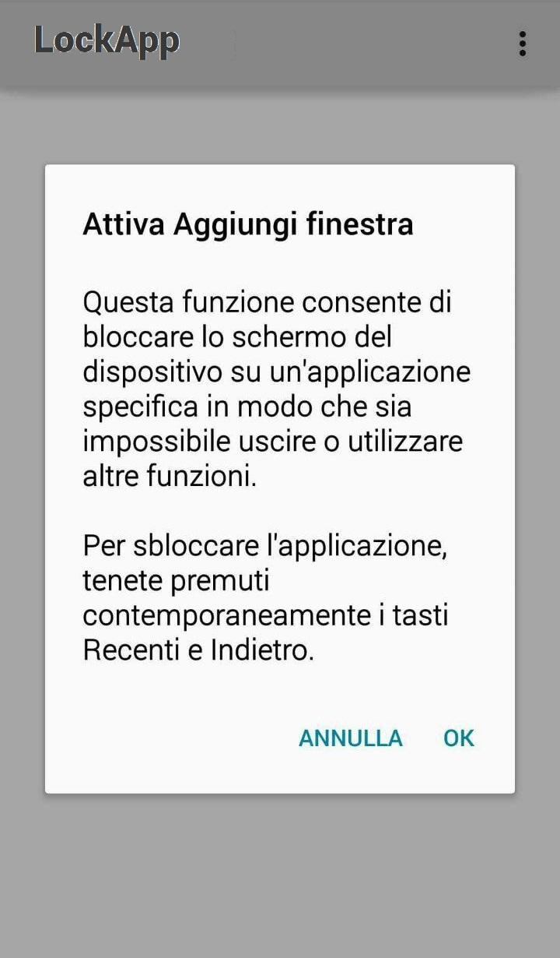
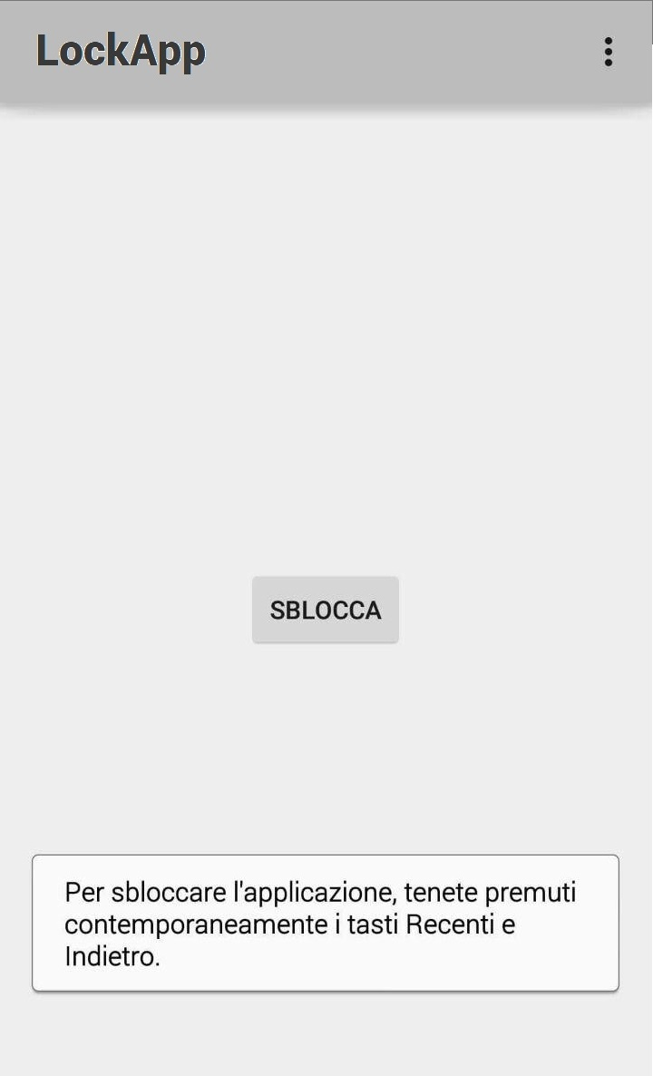
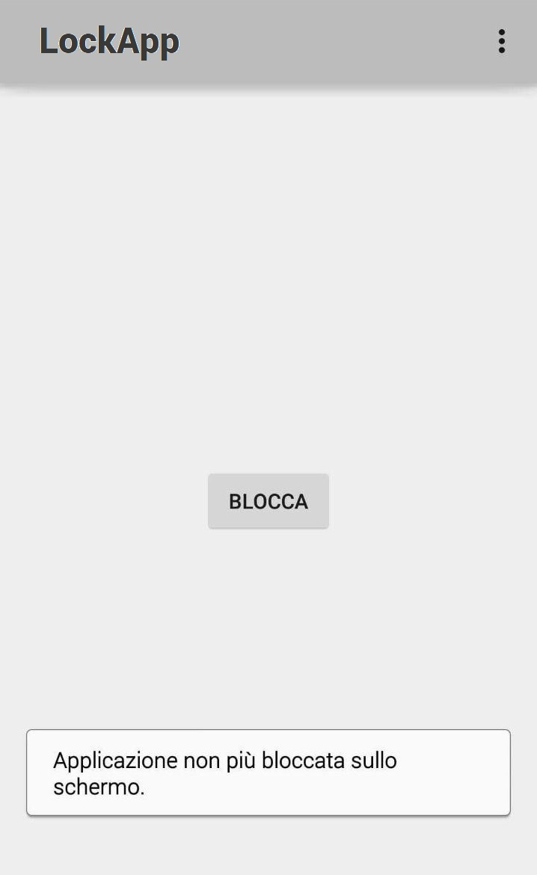
Limitations and Solutions
It is not possible to detect Power Button Key Press (Android security issue)
Home Button Key Press is never delivered through applications
StartLockTask() and StopLockTask() are two methods useful to our purpose, but ask the user for a confirmation in order to let him be aware of the Screen Pinning Situation (available only from Android 5.0 Lollipop). To avoid this, the Phone should be rooted and the app should be registered as a Device Owner App.

Slide 9
Thanks for your attention

